Slide 1
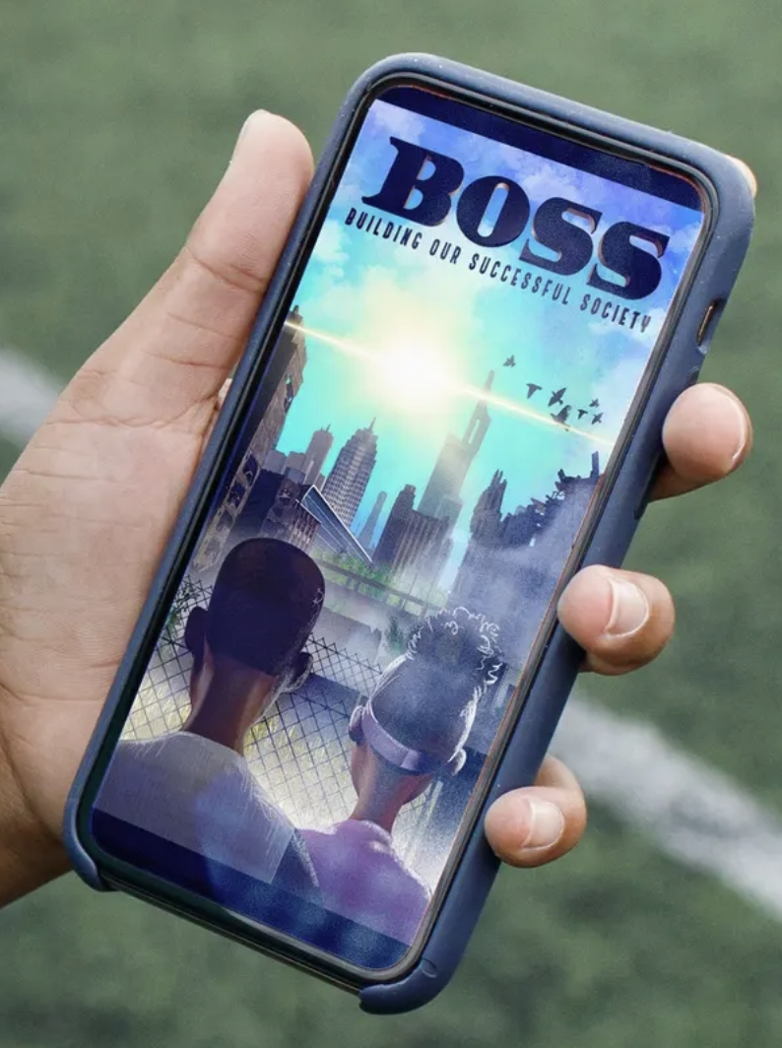
BOSS
Building our Successful Society
Subtitle
Date
CPPD

Slide 2
Agenda
The problem
What motivates Non-voters
How to connect with nonvoters
Solution
BIPOC voters voting significantly less
Feel their vote holds no power
42% of Gen Z trust news media
59% trust in public school
87% of gamers play video games for fun
competing for time with other forms of entertainment
Sense of belonging
High levels of video game playing among ages 18-30
Higher among less affluent households
Video game to empower voters
Meet people where they are and make voting an accessible subject

Slide 3
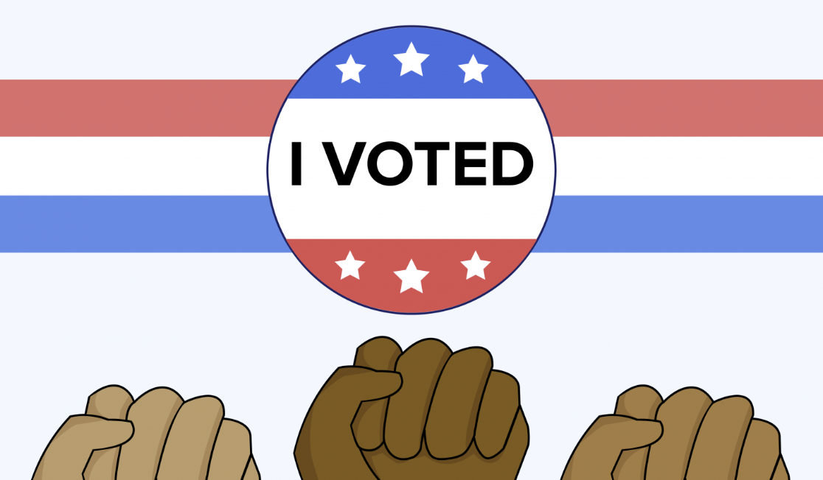
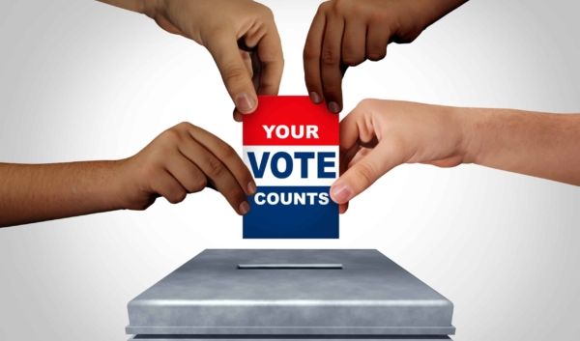
The Problem
In 2023, 51% of young Latinos and 44% of young African American adults were likely to vote in the presidential election
Continued decline in trust of legacy news, school institutions
Gen z has most active political citizens and most non active political citizens

Slide 4

What Motives Nonvoters
We know non voters are gaming mostly to have fun
Gaming elicits “herd mentality” which highlights people’s want for belonging
Want to leverage this in game play
BOSS will compete for time of non voter

Slide 5
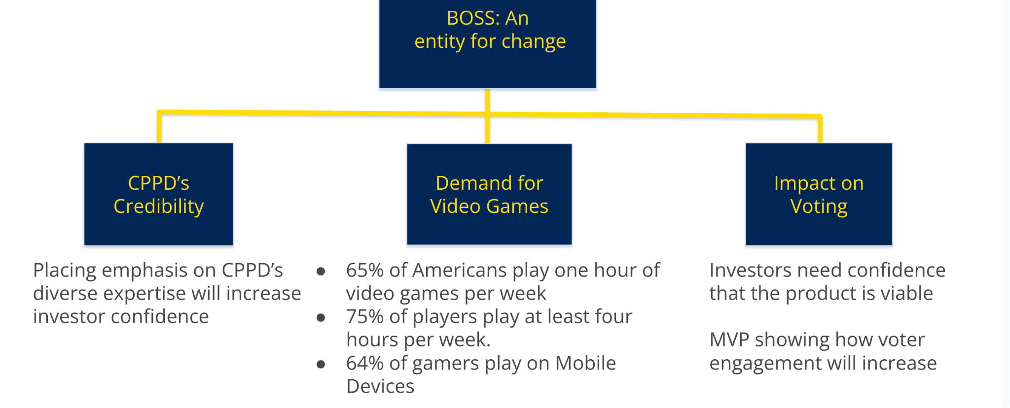
How to Connect With Nonvoters
Meet voters where they are in the form of a game
Encourage voting through plotlines of game that empower voters
More video games played at households that maker less than $30,000 vs. more
Sell non voters on enjoyment, immersion & empowerment

Slide 6

Solution
BOSS the game
Enjoyable game with implicit political lessons
Illicit herd mentality and cause nonvoters to feel sense of connectivity with community
Enable nonvoters to feel empowered in their community through voting

Slide 7
BOSS
Building our Successful Society
Subtitle
Date
CPPD

